Slide 1
Results and Inference

Slide 2
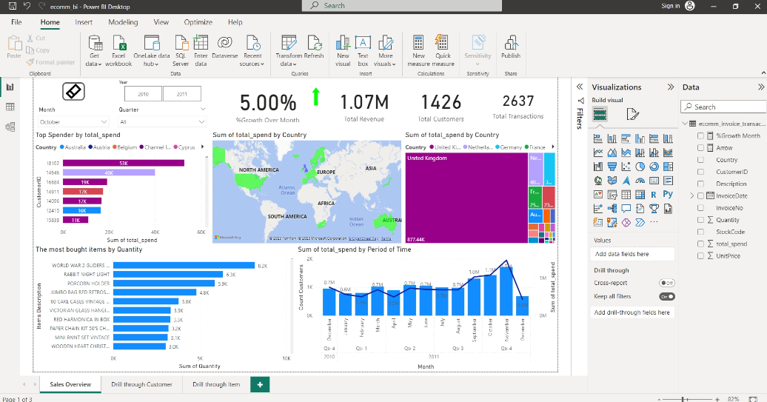

Slide 3
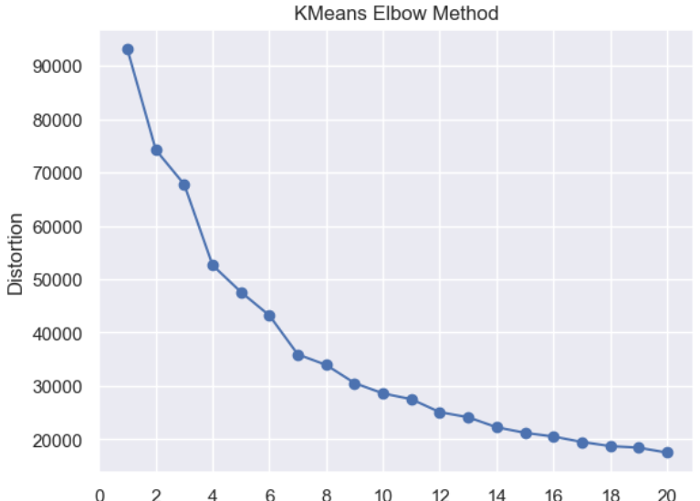

Slide 4
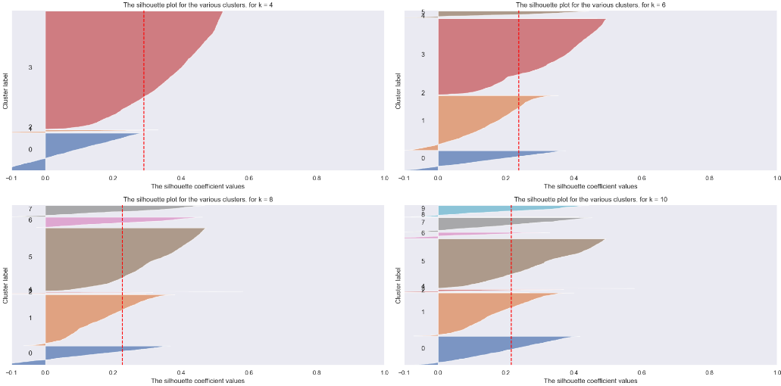

Slide 5
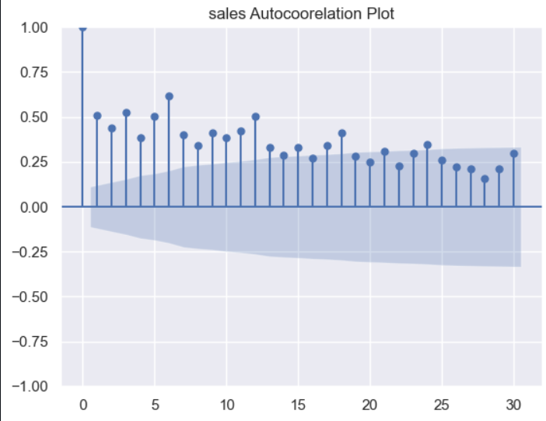

Slide 6
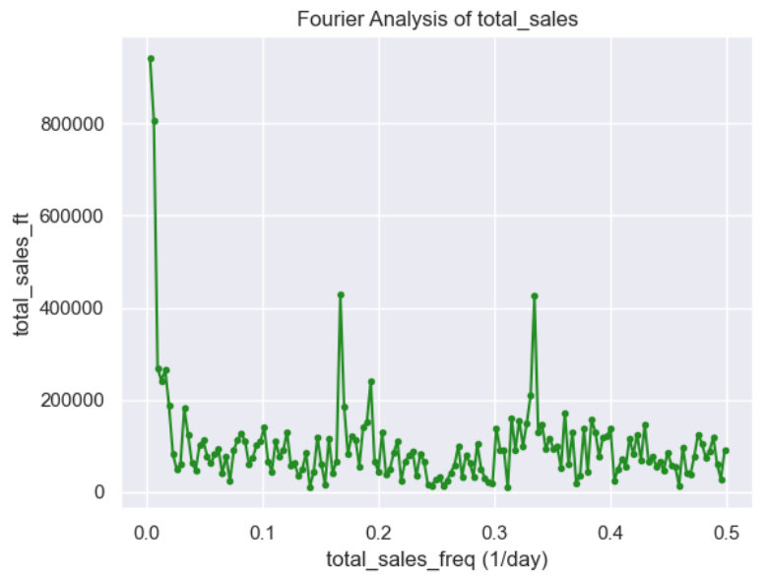

Slide 7
Workflow
Design a robust data architecture and carefully select appropriate tools for each stage of the project lifecycle.
Configure a virtualized environment to simulate local conditions, including database and web server setups.
Develop a comprehensive ETL (Extract, Transform, Load) process to gather data from diverse sources, perform necessary transformations, and populate the target database.
Leverage cloud-based solutions to expand the data lake and data warehouse capabilities for production use.

Slide 8
Construct an interactive dashboard for data visualization and in-depth business analysis.
Engineer and train machine learning models to forecast future sales, identify customer segments, and predict customer attrition rates.
Implement the developed models in a production environment, utilizing API web services and cloud infrastructure to drive business value.

